Slide 1

Town of Eureka
Public Meeting: June 29th, 2017
6:00pm: Eureka Town Hall
Wastewater Phase 1B
Project Review and Discussion

Slide 2

Needs of Community
Town of Eureka Planning Documents
Capital Improvement Plan 2015 update with update in progress
Strategic Plan approved July 2016
Lincoln County Comprehensive Economic Development Strategy 2013
Public Needs Assessment Survey and Process 2017 to update Town’s CIP and Strategic Plan
    Survey available.

Slide 3
The Concept
Areas of Focus
Connection of Midvale area users
Connection of 93 Business section and System Loop
Project Documents to Review
TSEP application that has been awarded is available for review at the Town Hall.
CDBG application is being drafted for final approval at the July 10th Council meeting.
Uniform Application available at the Town Hall- updated June 28th, 2017 from the TSEP application.
Handout of Figure 5-1

Slide 4
The Need
High Density of Septic in Identified residential area
Identified as high potential for ground water contamination
Older septic systems and Drain-fields
  Letter from the County Sanitation on conditions and support

Slide 5
Engineering Cost Analysis with
Total Project Cost Estimated at $1,310,000 +200,000

Slide 6

Potential Funding Scenario #1:
What we Tried First
Montana Department of Commerce
Treasure State Endowment Program (TSEP) $550,000 (received)
Montana Department of Natural Resources
Renewable resource Grant & Loan Program (rrgl): $100,000 (denied)
USDA- Rural Development Loan & Grant Combination Water & Environmental Program (WEP)- (Council Opted for 2nd Option due to administration costs associated with RD Funds)
    Grant of $164,000
    Loan of $491,000
Montana State Revolving Loan Fund: Interim Construction Financing

Slide 7
Potential Funding Scenario #2
What we are working on now
Montana Department of Commerce
  Treasure State Endowment Program (TSEP) $550,000
  Community Development Block Grant (CDBG)-Public Facilities
  $245,000 for Project
  Montana State Revolving Loan Fund (SRF) $532,000
  Town is working towards applying for Corp of Engineer Funds- these funds are a long shot and will be a “bonus” if received.

Slide 8

Impact to Residents & Businesses
Current Rate Structure
At this time Town of Eureka Residents on Sewer pay a monthly base rate of $47.52 plus usage fees.
Midvale Area users (who are not yet on the central Sewer system) are not paying monthly fees but plan for concerned pumping Tanks, septic failures, drainfield replacement etc.
Equivalent Maintenance for septic tank cost over 20 years is $44.00/month .

Slide 9

Preliminary and Estimated
Changes To RATES
If the Town is able to secure the Funding as outlined here it will result in current users and Midvale Users will see rates increase to $54 to $57. This is based on:
Having 693 users connected
(103 of current septic users in Midvale area and 590 current wastewater users)
NOTE: Town is seeking public input to see how many residents unserved will be connecting and when.
Loan Amount ($532,000 20 years at 2.5%)
Additional Operation and Maintenance costs of $24,000 annually

Slide 10
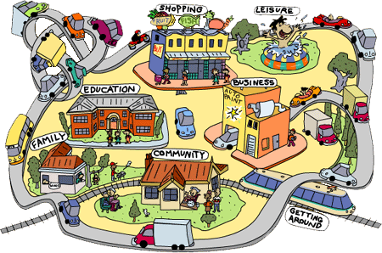
Community Benefit
Central sewer system
Improves value of properties
Increases marketability
Allows for Lots to be Split
Allows for Construction of second homes on property
Lifts restrictions on use of drainfield areas
Eliminates Pumping of septic systems
Avoids failing septic systems
Incentives to Hook up to Town Sewer during Construction:
  ½ Off hook up fees
  Potential funding for connection through CDBG Funding as explained earlier

Slide 11

Timeline of project
Applications
  TSEP sent in on May 4th, 2016 (available for review & approved)
  CDBG-PF July 2017
  State Revolving Loan Fund- July 2017
IF FUNDING IS RECEIVED AS OUTLINED TODAY (Best Case Scenario):
  Completion of Agency Contracts: September/October 2017
  Project Development, Engineering, Easements: October 2017-March 2018
  Easement/Surveying: March 2018-April 2018
  Procurement of Contractor: May 2018
  Construction of Project June 2018-December 2018

Slide 12

Questions and Public Comment
Written public comments will be accepted from
June 29th, 2017-July 10th, 2017
Written comments may be mailed to
PO Box 313
Eureka, MT 59917
Email to lschermerhorn@eureka-mt.gov
Comments are also accepted at the Town Hall

